Slide 1
Discover America Denmark
June 16th 2011

Slide 2
Program
17.30 – 18.00 Velkommen
18.00 – 18.30 Introduktion Discover America Denmark
18.30 – 19.00 Ole Egholm, Dansk Branche Analyse
19.00 - Q&A

Slide 3
Advisory Board
Karin Gert Nielsen, Direktør Atlantic Link
Jesper Ewald, Direktør FDM
Jesper Klausholm, Billund lufthavn
Per Markussen, BCD Nordisk chef
Jesper Schou, Direktør Billetkontoret
Peter Rasmussen, Direktør Profil
Michael Jensen, Production Manager Spies
Jens Vestergård, Sales Manager KLM/Air France/Delta
Carsten Nørland VP, CPH Lufthavne
Lars Thykier, Direktør DRF
Peter Strandby, Commercial Specialist US Embassy
Sekretariat: Charlotte Lindholm

Slide 4
Member fees
We will give 50% discount for 2011, for sign-ups before July 1st 2011
Member fee June 1st – December 31st 2011
Travel Agencies DKK 1,000
Scand. Suppliers DKK 1,500
U.S. Suppliers $ 250
Individual persons DKK 300
Member fee January 1st 2012 – December 31st 2012
Travel Agencies DKK 2,000
Scand. Suppliers DKK 3,000
U.S. Suppliers $ 500
Individual persons DKK 300
Media is FREE
Medlemsfordele
Deltagelse i DA DK events gratis
Newsletters
Adgang til member database + +
Member to member service
Listes på website incl. news
Arrangeres events for members
mod fee

Slide 5
Betalt i 2010 DKK 2500 Betalt i 2010 Nordisk $1200
Billetkontoret
DSB
FDM
Icelandair
Kuoni
Svane Rejser
Risskov Travel Partner
Hertz
SAS
Alaska Airlines
Continental Airlines
Cruise America
Alamo
Visit Florida
Avis
California Tourism
Euro USA
Minnesota Tourism
Florida Keys
Fort Lauderdale CVB
Mall of America
New York & CoNorth Dakota
St.Petersburg/
Clearwater CVB
Wellington Hotel, NY
Orlando Tourism
RCCL
Silverseas
Las Vegas
Fort Meyers
US Virgin Islands
Sea World

Slide 6
Members 2011 DK Members 2011 Nordisk
Rejsebureauer
Albatros Travel
BCD Travel
Billetkontoret
DSB
FDM
FlyAway
Holstebro Rejsecenter
Inter Travel
MyPlanet
Peacock Travel
Profil Rejser
Spies
Svane Rejser
Risskov Travel Partner
Unitas
USA Rejser
Leverandører
Alaska Airlines
Bella Center
Billund Lufthavn
CPH Lufthavne
Continental Airlines
Cruise America
Hertz
Icelandair
KLM/AF/DL
Messecenter Herning
SAS
Travelbroker
US members DK
City Pass
Amtrak
Visit Denver
Palm Springs Resort
Tropicana Las Vegas
Alamo
Visit Florida
Avis
California Tourism
Euro USA
Minnesota Tourism
Florida Keys
Fort Lauderdale CVB
Mall of America
New York & Co
North Dakota
St.Petersburg/
Clearwater CVB
Wellington Hotel, NY
Orlando Tourism
RCCL
Silverseas
Las Vegas
Fort Meyers & Sanibel
US Virgin Islands
Sea World

Slide 7
Budget 2011 (Juni – December)
Indtægter 2011/DKK
Overført fra 2009 85.144,30
Nordisk members 2010 19.778,82
DK members, 2010 28.990,61
Total 133.913,73
Udgifter 2010 43.176,00
Resultat pr 5.May 2011 90.737,73
Indtægter 2011
2011 – overført åbning 90.737,73
Nordisk members 2011 20.000,00
DK members, RBU’er (20) 20.000,00
DK members leverandør (20) 30.000,00
Total 165.737,73
Udgifter 2011 (1/2 år)
Sekretariat 75.000,00
Meetings, inkl. Nordisk 5.000,00
Events 20.000,00
Andet web etc. 10.000,00
Total 110.000,00
Resultat 50.737,73
(der er ikke medtaget evt. sponsor indtægter)

Slide 8
Budget 2011 (Juni – December)

Slide 9
Budget 2012
Regnskabsår – kalenderår
Indtægter
Overført fra 2011 50.000,00
Nordisk members 2012 20.000,00
DK members, RBU’er (20) 40.000,00
DK members leverandør (20) 60.000,00
US members ($500 x 5) 12.500,00
Total 182.500,00
Udgifter
Sekretariat 100.000,00
Meetings, incl Nordisk 10.000,00
Events 30.000,00
Andet web etc 10.000,00
Total 150.000,00
Resultat 32.500,00 (der er ikke medtaget evt sponsor indtægter)

Slide 10
Sekretariatet v/Atlantic Link
Årlig fee DKK 100.000 (udbetales halvårlig 1. Januar og 1. Juli)
Opgaver
PR, newsletters, pressemeldinger
Web
Medlemmer, kontakt, vedligehold database etc.
Økonomi
Events, workshop, road shows
Discover A Nordisk (samarbejde)
Messer Bella og Ferie for Alle
Member to member service Leverandører til RBU’er
US Travel Association
Kontakt / samarbejde med organisationer i DK og eksternt US Travel Association

Slide 11
Discover America Denmark event | Member meeting | Copenhagen, Denmark | June 16th 2011 | Open for all
Discover America Nordic | Board meeting | Stockholm, Sweden | June 20th 2011 | Board only
Discover America Norway | Trade/Media | Oslo, Norway | July 1st 2011 | Trade only, 4th of July celebration
Workshop, Jutland Denmark | Workshop | Aarhus, Denmark | August 18th 2011 | 150 travel agents and Media
Discover America Denmark | Board meeting | Copenhagen, Denmark | August 29th 2011
Discover America Denmark & NYC & Co | Trade/media | Copenhagen, Denmark | September 27th 2011 | In coop with NYC & Co
Eventdagen | Trade/Media | Copenhagen, Denmark | October 13th 2011 | Arranged by Kursuslex Denmark, MICE
Workshop, Vagabond, PATA, Discover America | Trade/media | Copenhagen Denmark | October 21st 2011 | Day before Luxury fair at the fairground 15 – 17.00
Luxury Show, Øksnehallen | Consumer | Copenhagen | October 22nd – 23rd 2011 | Luxury travel fair, 15,000 visitors
Long Haul workshop | Workshop | Denmark | November 2nd - 3rd 2011 | 500 travel agents and media in co-op with PATA
Thanksgiving celebration | Trade & media | Copenhagen, Denmark | November 10th 2011 | 300 travel agents
Matka/Helsinki | Trade & consumer show | Helsinki, Finland | January 19-22 2012
Visit Florida road show | Trade/Media | Oslo, Stockholm, Copenhagen | February 6th – 9th 2012 | Organized by Discover America and Visit Florida
FERIE 2012 | Trade & consumer show | Copenhagen, Denmark | Feb 10th – 12th 2012 | 30,000 visitors
FERIE FOR ALLE | Trade & consumer show | Herning, Denmark | February 24th – 26th 2012 | 60,000 visitors
Discover America Norway | Trade/Media | Oslo/ Norway | March 1st 2012 | Workshop
Reiseliv Norway | Trade & consumer show | Oslo, Norway | March 2nd – 4th 2012
Swansons Consumer show | Consumer | Swansons, Sweden | March 3rd 2012 | 1,000 guest visit Fort Swansons
Discover America Denmark | Workshop | Copenhagen, Denmark | March 5th 2012 | 100 travel agents
ITB | Trade & consumer show | Berlin | March 7th – 11th 2012
TUR | Trade & consumer show | Goteborg Sweden | March 23-25. 2012
Pow Wow | Trade/Media | Los Angeles | April 21st – 25th 2012
Notes:
Activity plan 2011/2012 for Discover America Nordic

Slide 12
FERIE FOR ALLE 24 – 26 februar 2012

Slide 13
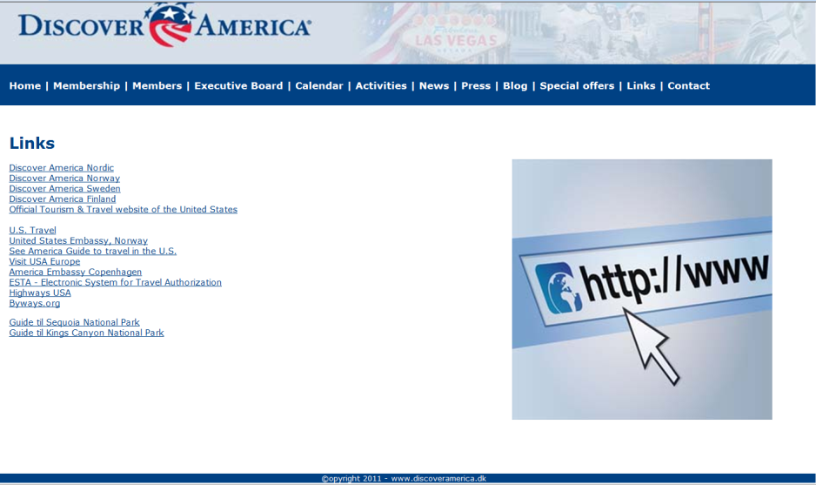
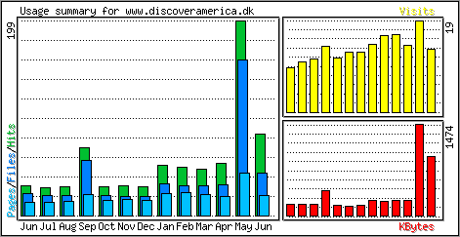
Discoveramerica.dk
Blog v/Henrik Lange
Link til highways.dk
Banner annoncering for members
Banner annoncering for sponsors

Slide 14
Visitors from Denmark to USA & Asia Pacific 2010

Slide 15
Arrivals 2010 vs 2009 from Denmark to USA & Asia Pacific

Slide 16
Lastest Arrival Figures
From Nordic Region to US total 2000 - 2010

Slide 17
Facts & Figures – Scandinavian & Finland
International arrivals to US, 2010
Country | International Arrivals | Population / % Travel to US
United Kingdom | 3.889.167 | 59.647.790 / 6,52 %
Germany | 1.686.825 | 83.029.536 / 2,03 %
France | 1.300.000 | 59.551.227 / 2,02 %
Nordic Region | 1.002.779 | 24.484.997 / 4,09 %
Italy | 753.310 | 57.679.825 / 1,31 %

Slide 18
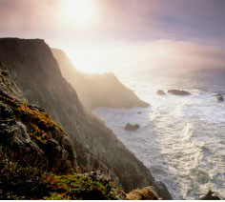
Facts & Figures – Scandinavian & Finland
International arrivals to US, 2010
Sweden 371.853 + 15%
Denmark 258.788 +5%
Norway 221.145 +14%
Finland 111.840 -2%
Iceland 39.153 +37%
Total 1.002.779
2009 906.248

Slide 19
Facts & Figures – Scandinavia & Finland
Length of stay & daily spending per visitor per day
Nordic leisure visitors 17,5 nights
Per visitor per trip/day spending in US $ 1.890/$108
France 8,6 nights $ 929/$108
UK 9,5 nights $ 1.007/ $106
Germany 12,2 nights $ 1.000/ $ 82
Average for all visitors (leisure) was 11,7 nights
Total spending per visitor $1.205 ($103 per day)

Slide 20
Facts & Figures – Scandinavia & Finland
California marketing budget 2010/2011, $60.000
CTTC spend per visitor
United Kingdom $7,65
Germany $4,19
Nordic Region $2,32

Slide 21
“What is/was the MAIN purpose of your trip…”
Source: U.S. Department of Commerce, Office of Travel and Tourism Industries.
Notes:
When asked “What was the main purpose of your trip,” the overwhelming majority of overseas visitors traveling in the United States claimed to be here for leisure/recreation/holidays, followed by visiting friends and relatives (21%), and business travel (18%).

Slide 22
“Which leisure activities did you spend time on…”
Source: U.S. Department of Commerce, Office of Travel and Tourism Industries.
Notes:
They love shopping in the United States, going out to eat in our fine restaurants, seeing the sights of our major cities, but also like visiting small towns and historical places.

Slide 23
“How did you obtain information used to plan your trip?”
Source: U.S. Department of Commerce, Office of Travel and Tourism Industries.
Notes:
They primarily obtain information to plan their trip using a computer, which increased 7 percentage points last year alone. These gains are coming at the expense of travel agencies, though precisely a third (33%) continue to plan their trip via travel agencies.

Slide 24
17 of the Top 50 Overseas Markets Set Visitation Records in 2010
Country of Residence | 2010 Visitation Total (000) | Year of Previous Record
France | 1,342 | 2008
Brazil | 1,198 | 1997
South Korea | 1,108 | 2007
Australia | 904 | 2009
Italy | 838 | 2008
People’s Republic of China | 802 | 2009
India | 651 | 2008
Colombia | 495 | 2009
Denmark | 259 | 2008
Norway | 221 | 2008
Ecuador | 196 | 2009
New Zealand | 175 | 1990
Russia | 175 | 2008
Panama | 119 | 2009
Turkey | 115 | 2008
Portugal | 94 | 2008
Nigeria | 16 | 2008

Slide 25
Forecast of International Travelers to the United States by Top Origin Countries

Slide 26
Forecast of International Travelers to the United States by Top Origin Countries

Slide 27
Visitations to the United States: Business Travel (1) vs Pleasure Travel from selected countries
Visitation to the United States: Business Travel (1) vs. Pleasure Travel from Selected Overseas Countries
 |  |  | Year to Date January 2011
 | Percent | Percent |  |  | Percent | Total | Business | Pleasure
 | Change | Change | Pleasure |  | Change | Overseas | Travel | Travel
Country | Business | Pleasure | Arrivals | Total | Total | Arrivals | Percent | Percent
of Residence | Travelers | Travelers | Rank | Arrivals | Arrivals | Rank | of Total | of Total
Japan | 21 | 3 | 1 | 267.686 | 4 | 1 | 11,5% | 86,1%
United Kingdom | 28 | -7 | 2 | 193.177 | 2 | 2 | 30,6% | 67,3%
Brazil | 22 | 29 | 3 | 144.981 | 28 | 3 | 8,3% | 88,2%
South Korea | 13 | 28 | 4 | 117.021 | 19 | 4 | 14,8% | 64,8%
Australia | 20 | 28 | 5 | 71.293 | 27 | 7 | 15,2% | 83,4%
Germany | 26 | -17 | 6 | 84.403 | -3 | 6 | 40,5% | 55,5%
France | 33 | 15 | 7 | 70.014 | 19 | 8 | 30,0% | 65,3%
People's Republic of China (EXCL HK) | 8 | 122 | 8 | 100.207 | 49 | 5 | 22,2% | 40,5%
Argentina | 3 | 21 | 9 | 42.557 | 19 | 11 | 8,9% | 89,7%
Italy | 41 | 1 | 10 | 48.906 | 9 | 9 | 25,0% | 71,0%
Spain | 36 | 4 | 11 | 32.562 | 10 | 12 | 20,7% | 71,7%
Colombia | -8 | 7 | 12 | 29.225 | 5 | 13 | 13,3% | 79,3%
Venezuela | -6 | 0 | 13 | 28.457 | 2 | 16 | 12,0% | 78,2%
Netherlands | 28 | -8 | 14 | 29.164 | 3 | 14 | 39,8% | 58,0%
India | 5 | 32 | 15 | 47.323 | 13 | 10 | 31,7% | 33,8%
Sweden | 32 | -3 | 16 | 24.597 | 6 | 17 | 28,8% | 63,9%
ROC (Taiwan) | -7 | 32 | 17 | 28.538 | 10 | 15 | 25,0% | 50,6%
Costa Rica | -11 | -1 | 18 | 16.969 | -2 | 22 | 12,8% | 84,0%
Russia | 24 | 45 | 19 | 18.754 | 39 | 19 | 19,2% | 73,1%
Ireland | 64 | -18 | 20 | 18.241 | -5 | 20 | 25,2% | 72,1%
Total Overseas (2)
Non-Resident Visits | 16 | 7 |  | 1.821.897 | 9 |  | 20,8% | 68,7%
Source: U.S. Department of Commerce, Office of Travel & Tourism Industries
(1) The monthly figures on all travelers from each country to the United States represent mainly
business, pleasure and student travelers. For some countries, there is a difference in the rate of
change by the type of visa. The table above shows these differences for the top 20 overseas
tourist-generating countries, specifically the change in business travel versus pleasure travel.
(2) "Overseas" excludes Canada and Mexico.

Slide 28
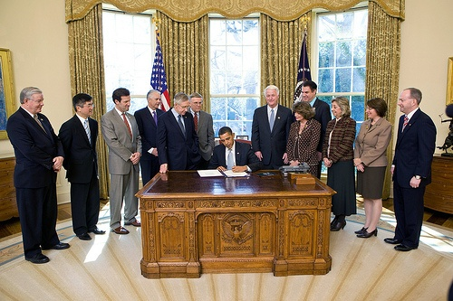
CPT, Corporation for Travel Promotion
Signed by President Obama 2010
Purpose:
Establishes an independent nonprofit Corporation for Travel Promotion:
To promote the U.S. to world travelers
To argument communications on entry/exit policies
Establish a goal for wait times at international airports and cruise terminals of less than 20 minutes and measure the performance against that goal.
Visa Issues for media and press
Welcoming environment
Notes:
A momentous day in the Oval Office, to be sure. March 4, 2010, marked the signing of the Travel Promotion Act (TPA).
As President Obama was leaving the Oval Office, he said to Secretary Locke , “Gary Locke, be sure you do this right!”
Secretary Locke has been working very hard to ensure that the TPA and the Corporation for Travel Promotion (CTP) are rolled out appropriately, accurately, and expeditiously.
The CTP’s key responsibility is to promote the United States to the world’s travelers and to augment USG communications on entry/exit policies.

Slide 29
CPT, Corporation for Travel Promotion
ESTA, $14 (two year validity), only visa waiver countries
$4 Homeland security
$10 Travel promotion
$200.000 budget
$300.000 collected daily
Key growth markets: Brasil, China, India
Primary markets: UK, Germany, Canada
Q: will CPT re-invest the countries where collected, or focus on emerging and primary
markets
Nordic Region contributed in 2010 by 1.000.000 visitors = $10.000.000

Slide 30
Airline update
Eight (13) airlines will be operating 165 weekly departures between Scandinavia and US from summer 2011, the largest ever counted, 17 different routes in total. SAS counts for 35 departures.
Airlines between the Nordic Region and US via their respective hubs:
American Airlines,
Continental,
Delta Air Lines,
Finnair,
Icelandair,
Iceland Express,
SAS,
US Airways, Air Canada,
British Airways,
KLM,
Air France,
Important news from 2011:
BA via London to SAN DIEGO, from Summer 2011
KLM via Amsterdam to MIAMI 2011
FI via Iceland to Washington
Delta to Atlanta

Slide 31
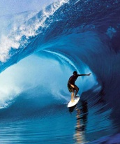
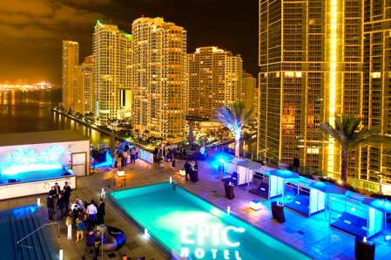
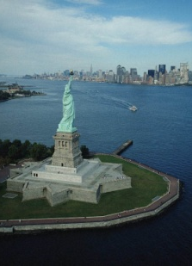
Unserviced routes– CPH 2010 total traffic
Nr. Airport PAX
1. LAX Los Angeles 68.812
2. SFO San Fransisco 60.190
4. MIA Miama 56.806
7. Mco Orlando 33.222
9. BOS Boston 33.069
23. SEA Seattle 19.559

